Slide 1
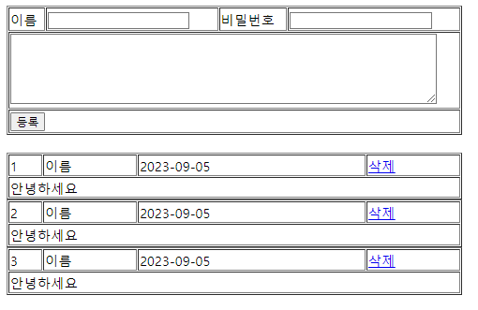
GuestBook3 분석
01
분석-리스트
http://localhost:8088/GuestBook3/GBC?
action=addList
Request(요청)
Tomcat
GuestBook3
Request header
Request body
(파라미터)
: action
Controller(servlet) 객체
GuestDao 객체
request
addList
일때
guestSelect()
response
포워드
request
Response(응답)
addList.jsp
객체
Response header
Response body (html)
response
DB
http://localhost:8088/GuestBook3/GBC?action=addList

Slide 2
GuestBook3 분석
01
분석-등록
http://localhost:8088/GuestBook3/GBC?
action=insert&name=지호&password=1234&content=안녕하세요
Request(요청)
Tomcat
GuestBook3
Request header
Request body
(파라미터)
: action, name,
password, content
Controller(servlet) 객체
GuestDao 객체
request
insert일때
guestInsert(vo)
response
Response(응답)
Response header
Response body (리다이렉트코드) : addList
DB
http://localhost:8088/GuestBook3/GBC?action=addList

Slide 3
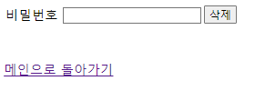
GuestBook3 분석
01
분석-삭제폼
http://localhost:8088/GuestBook3/GBC?
action=deleteForm&id=3
http://localhost:8088/GuestBook3/GBC?
Request(요청)
Tomcat
GuestBook3
Request header
Request body
(파라미터)
: action, id
Controller(servlet) 객체
request
delete
Form일때
response
포워드
request
deleteForm.jsp
객체
Response(응답)
response
Response header
Response body (html)

Slide 4
GuestBook3 분석
01
분석-삭제
http://localhost:8088/GuestBook3/GBC?
action=delete&id=3&password=1234
http://localhost:8088/GuestBook3/GBC?
Request(요청)
Tomcat
GuestBook3
Request header
Request body
(파라미터)
: action, id, password
Controller(servlet) 객체
GuestDao 객체
request
delete일때
guestDelete(3)
response
Response(응답)
Response header
Response body (리다이렉트코드) : addList
DB
http://localhost:8088/GuestBook3/GBC?action=addList

